Slide 1

AUTOMATED MALARIA CELL CLASSIFICATION USING DEEP LEARNING

Slide 2
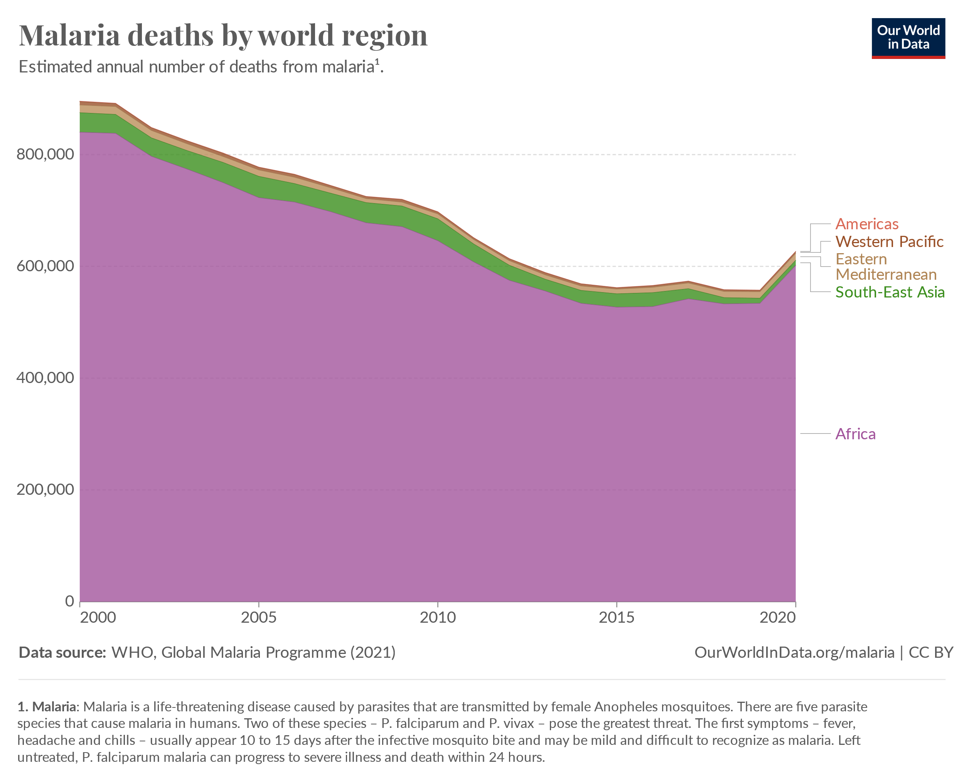
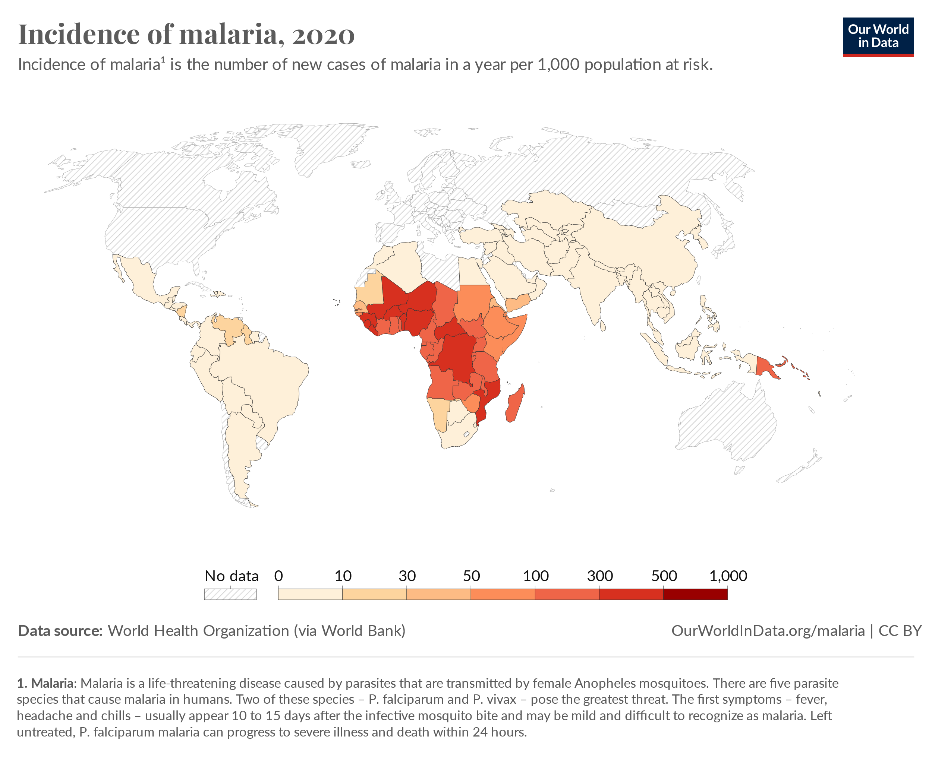
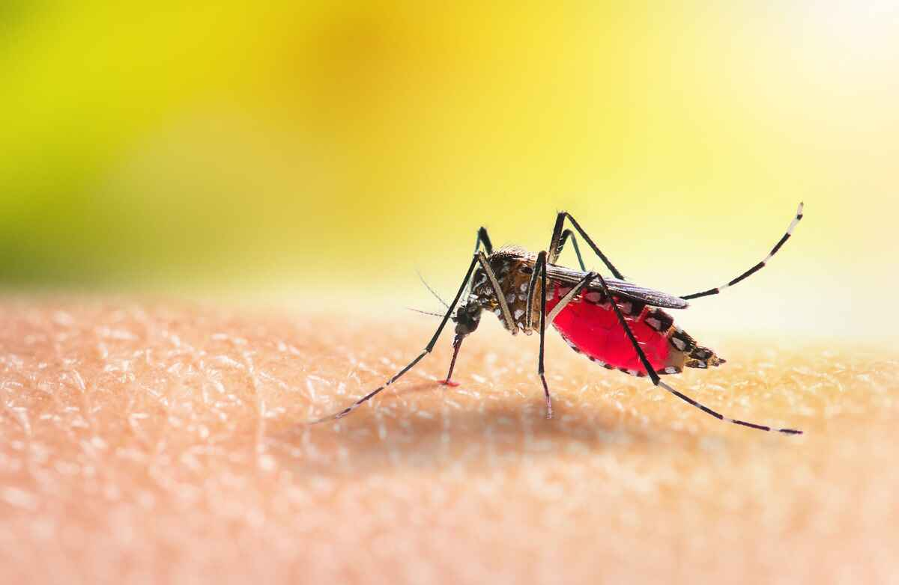

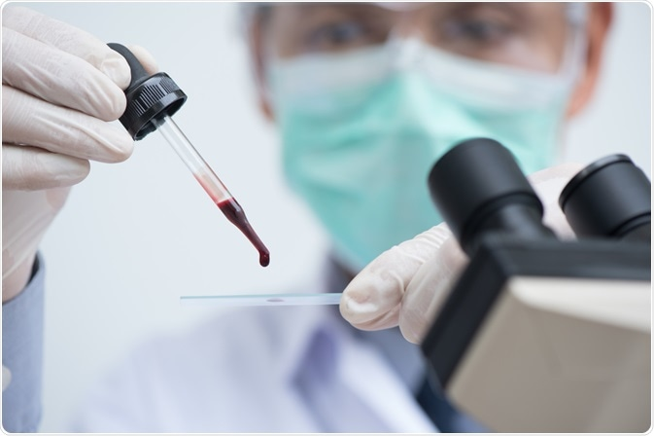
Traditional
Vs
DeepLearning
Diagnosis
STATISTICS
Etiology

Slide 3

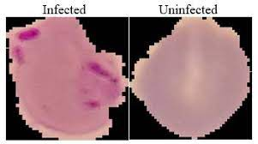
DATA SOURCE
This Dataset is taken from the official NIH Website:
https://ceb.nlm.nih.gov/repositories/malaria-datasets/
Content
The dataset contains 2 folders
Parasitized
Uninfected
And a total of 27,558 cell images.

Slide 4
Literature Review

Slide 5

A simple and efficient method for parasite and erythrocyte detection in thin blood images was proposed; the approach is based on a classification process that finds boundaries that optimally separate a given color space in three classes, namely, background, erythrocyte and parasite (DiazFabio & Romero, 2007)
The image-based method is tested over more than 500 images from two independent laboratories; overall sensitivity to capture cases of malaria is 100% and specificity ranges from 50-88% for all species of malaria parasites. (Purwar, et al., 2011)
Two back propagation Artificial Neural Network models (3 layers and 4 layers) was employed together with image analysis techniques to evaluate the accuracy of the classification in the recognition of medical image patterns associated with morphological features of erythrocytes in the blood. The three layers Artificial Neural Network (ANN) architecture had the best performance with an error of 2.74545e-005 and 86.54% correct recognition rate (Hirimutugoda & Wijayarathna, 2010)

Slide 6



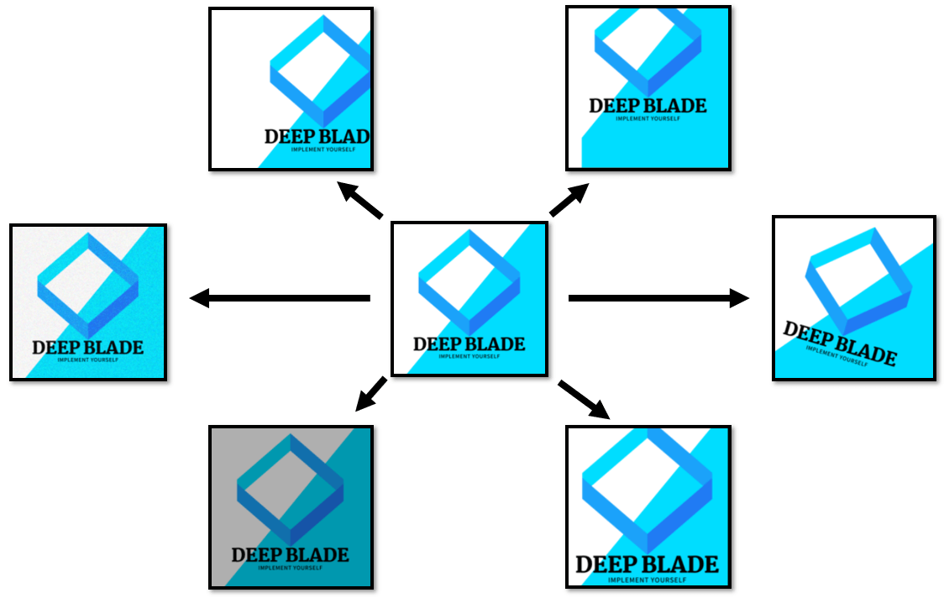

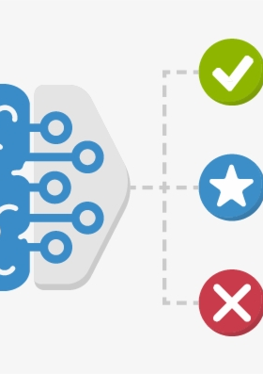

WORKFLOW
Importing Libraries

Slide 7
WORKFLOW
Data Preparation

Slide 8

WORKFLOW
Data Visualization

Slide 9
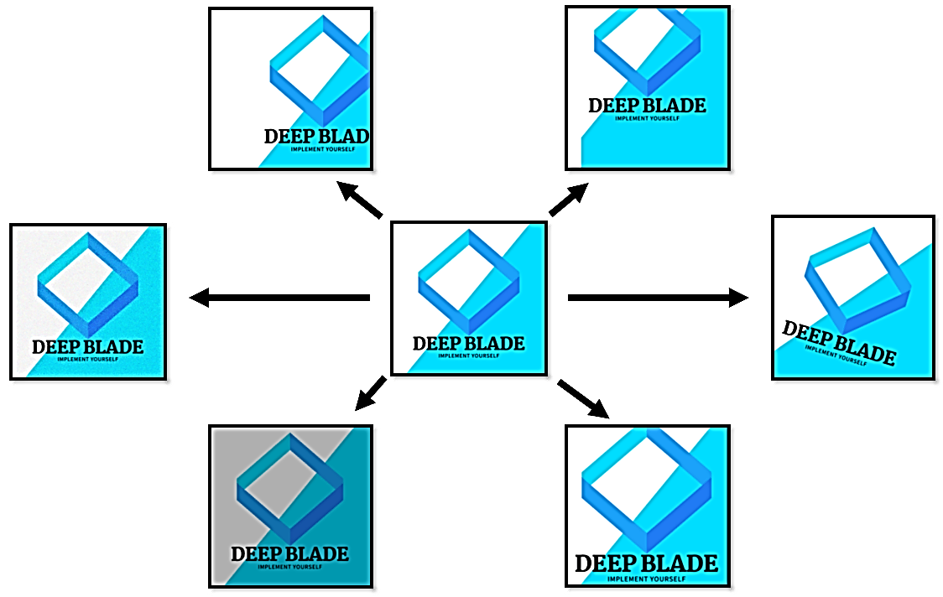
WORKFLOW
Data Augmetation

Slide 10


WORKFLOW
Model Building & Training

Slide 11

WORKFLOW
Model Evaluation

Slide 12

WORKFLOW
Results Visualization

Slide 13
ARCHITECTURE

Slide 14
IMAGE
Input
Layer
Dense
Layer
Output
Layer
Convolution layers and Max pooling layers
CNN Architecture

Slide 15

RESNET 50 ARCHITECTURE
ResNet50
Our Input data
Output
data
50 layers
48 Conv layers
1 Max pool
1 Average pool

Slide 16
EfficientNet B2
Architecture
Our Input data
Output
data

Slide 17

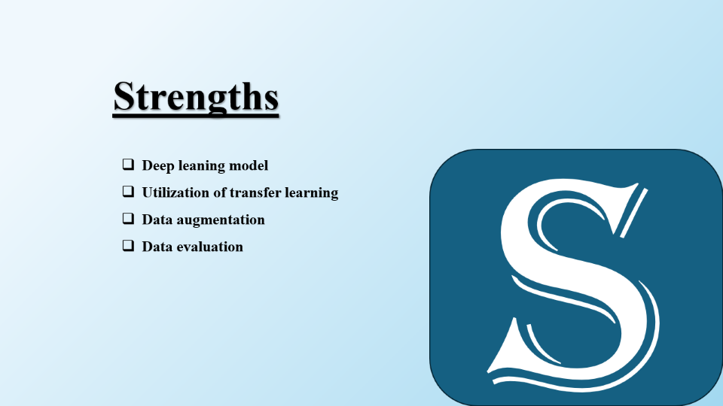



Slide 18
Strengths
Deep leaning model
Utilization of transfer learning
Data augmentation
Data evaluation
s

Slide 19
Weaknesses
Overfitting
Limited Model Exploration
Data Imbalance Handling
Evaluation Metrics
W

Slide 20
O
Opportunities
Hyperparameter Tuning
Ensemble Learning
Deployment

Slide 21
T
THREATS
Data Quality
Computational Resources
Ethical Concerns

Slide 22

THANK YOU
Venkata Sandeep Pamarthi
Susmitha Bommini
Anjum A Shaik

Slide 24


1 | Numpy
2 | Pandas
3 | OS
4 | Tensorflow
5 | Sklearn
6 | Matplotlib
7 | Seaborn
8 | Cv2
9 | pprint
10 | datetime
11 | warnings
12 | zipfile

Slide 25
Data Preparation
Defining paths
Creating df
Concatenate
df
Shuffle
Split
Parasited_paths
Uninfected_paths
Training
Testing
train_df, test_df = train_test_split(df, test_size=0.1, random_state=42)

Slide 26

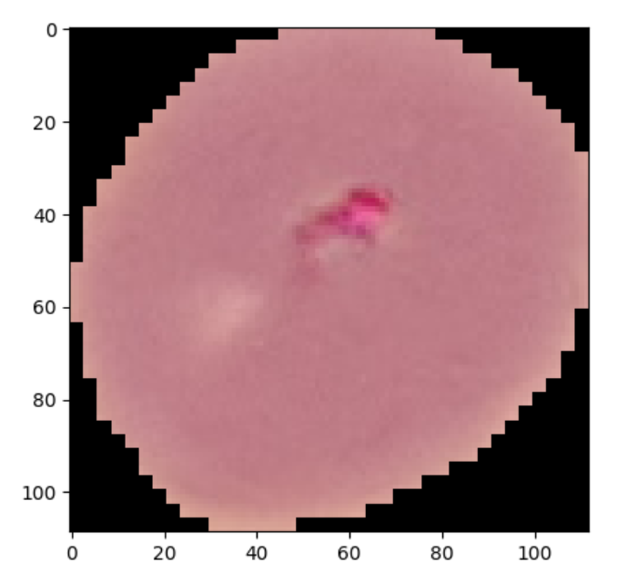
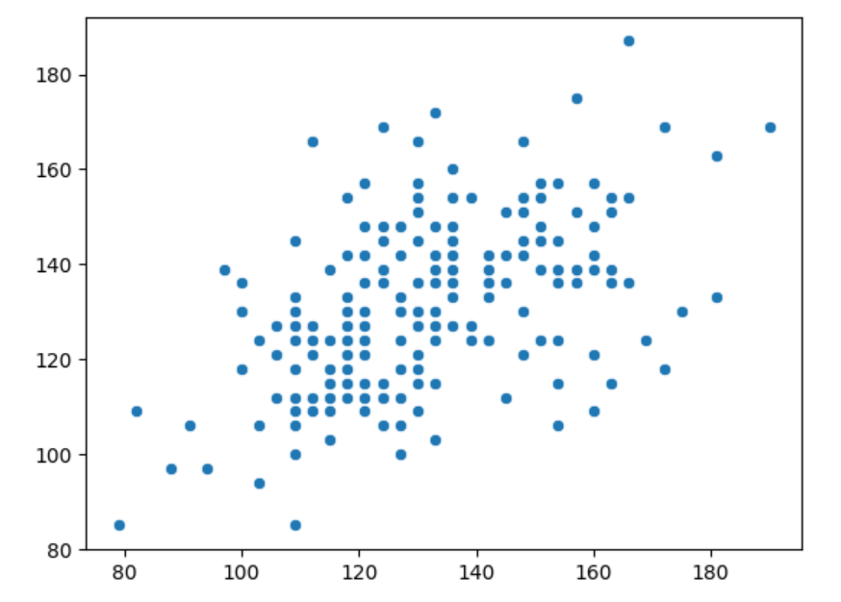
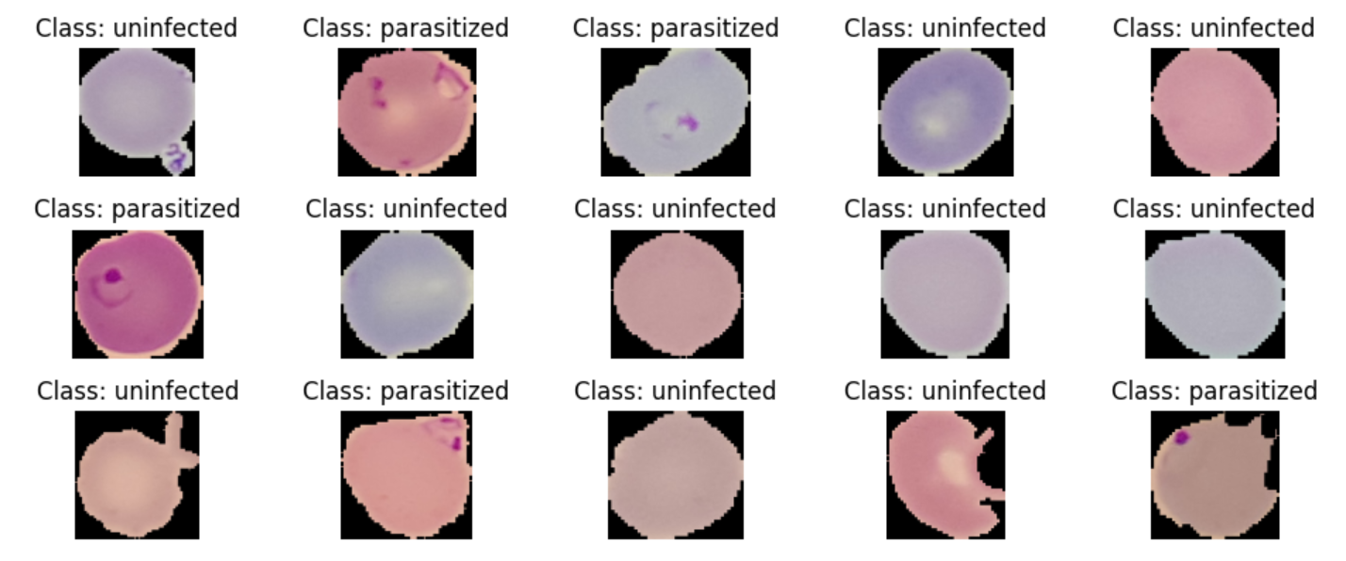
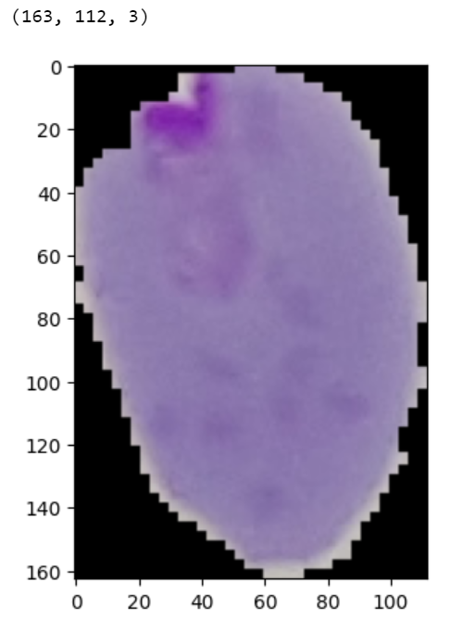

Slide 27
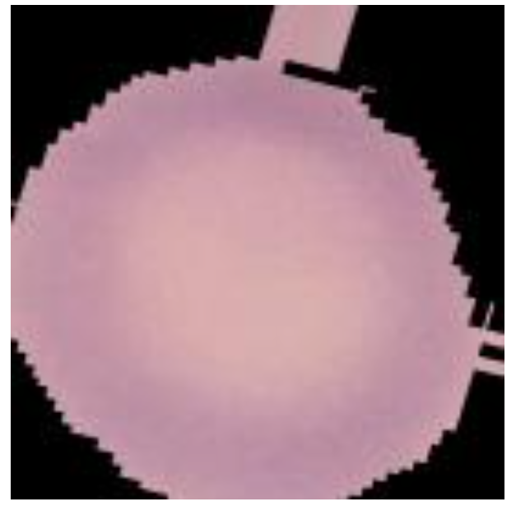
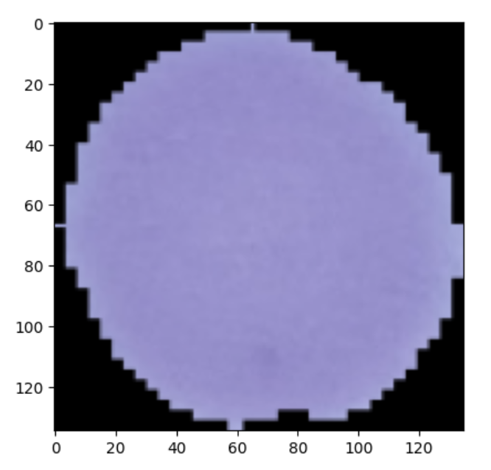
Data Augmetation
train_image_data_generator = ImageDataGenerator(
rotation_range=20,
width_shift_range=0.10,
height_shift_range=0.10,
shear_range=0.1,
zoom_range=0.1,
horizontal_flip=True,
fill_mode='nearest',
validation_split=0.2
)

Slide 28
Model Building & Training
Defined the architecture of custom CNN model
Model compilation with loss function, optimizer and metrics
ResNet50 and EfficientNet B2 models with pre-trained model
Custom layers on top of the pre-trained models
Model compilation with loss function, optimizer and metrics
Training the custom CNN and Resnet50,EfficientNetB2 models using fit method

Slide 29
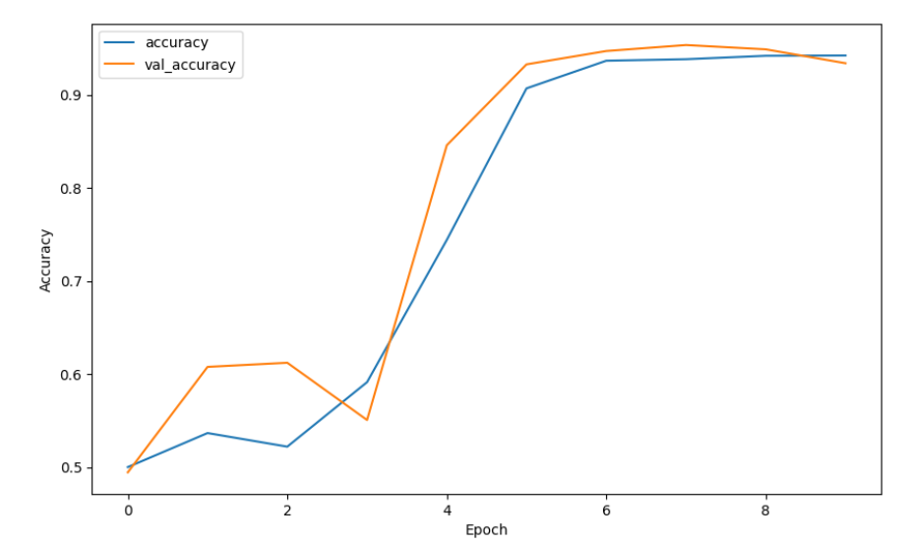
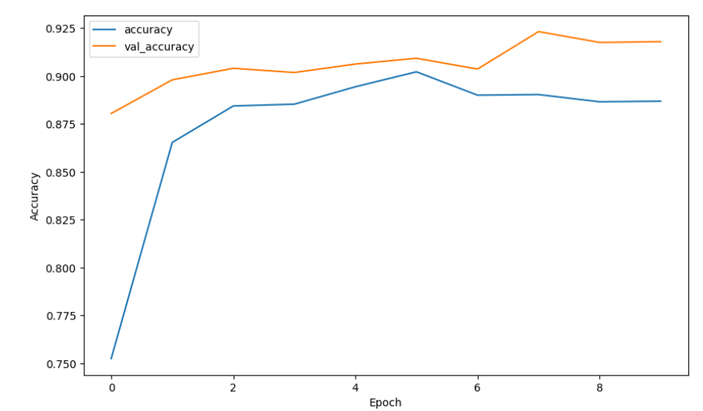
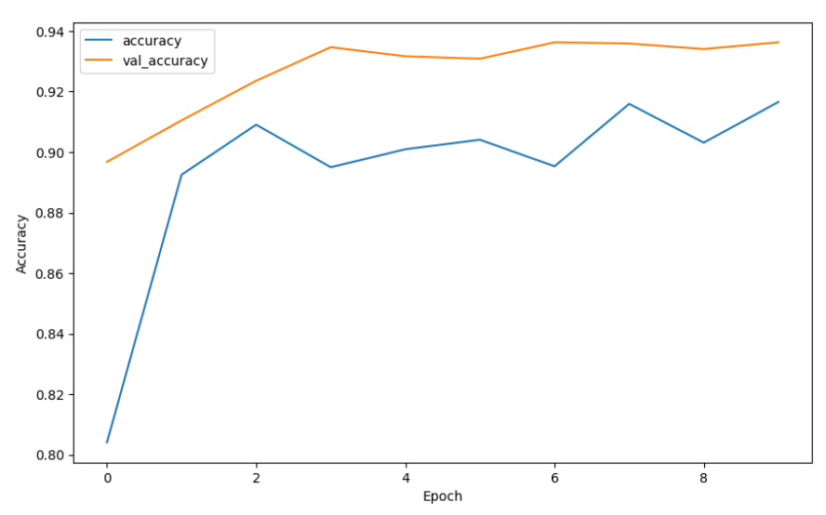
Model Evaluation
CNN
93%
ResNet50
89%
EfficientNetB2
94%

